Slide 1

CI/CD for SPFx with Azure DevOps
Rifaj Aboobacker
Solutions Architect, Earth9.com
@rifaj

Slide 2
Agenda
Why CI/CD
CI for SharePoint framework
CD for SharePoint framework
Hands On Lab
Q&A

Slide 3
Prerequisites
Node.js v10.x. - https://nodejs.org/en/
Visual Studio Code
Yeoman and Gulp - npm install -g yo gulp
Yeoman SharePoint generator - npm install -g @microsoft/generator-SharePoint
Azure DevOps account - https://dev.azure.com/
Git
Setup App catalog site – Optional

Slide 4
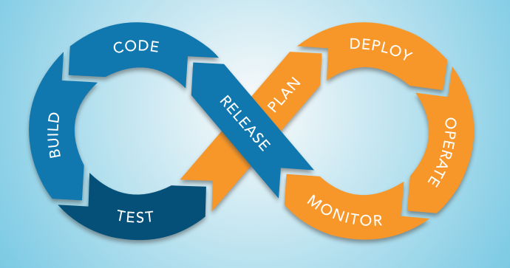

Slide 5
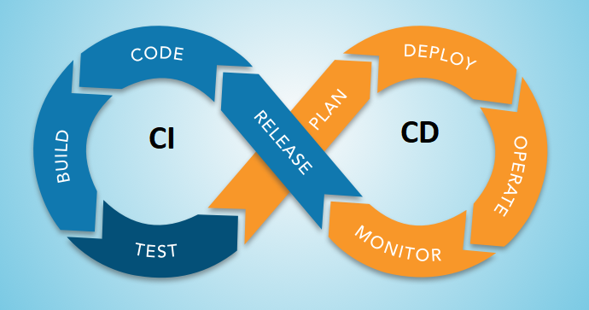

Slide 6
Continuous Integration
Continuous Integration (CI) helps developers integrate code into a shared repository by automatically verifying the build using unit tests and packaging the solution each time new code changes are submitted.

Slide 7
Continuous Delivery
Continuous Deployment (CD) takes validated code packages from build process and deploys them into a staging or production environment.
Developers can track which deployments were successful or not and narrow down issues to specific package versions.

Slide 8
Benefits
Automate tedious tasks
Help developers stay focused
Reduce regression testing effort
Effortless product updates
More effective feedback loop
Detect and fix issues early

Slide 9
Other benefits
Increased speed of innovation and ability to compete in the marketplace
Code in production is making money instead of sitting in a queue waiting to be deployed
Great ability to attract and retain talent
Higher quality code and operations due to specialization

Slide 10
CI / CD for SPFx
Maintaining the SPFx solutions for their integrity as they grow is challenging
Continuous development efforts, testing and deployment of the latest released package is a huge task
SharePoint Framework builds, unit tests, and deployment can be automated

Slide 11
Steps
Creating a new pipeline
Installing NodeJS
Restoring dependencies
Executing Unit Tests
Importing test results
Importing code coverage information
Bundling the solution
Packaging the solution
Preparing the artifacts
Publishing the artifacts

Slide 12
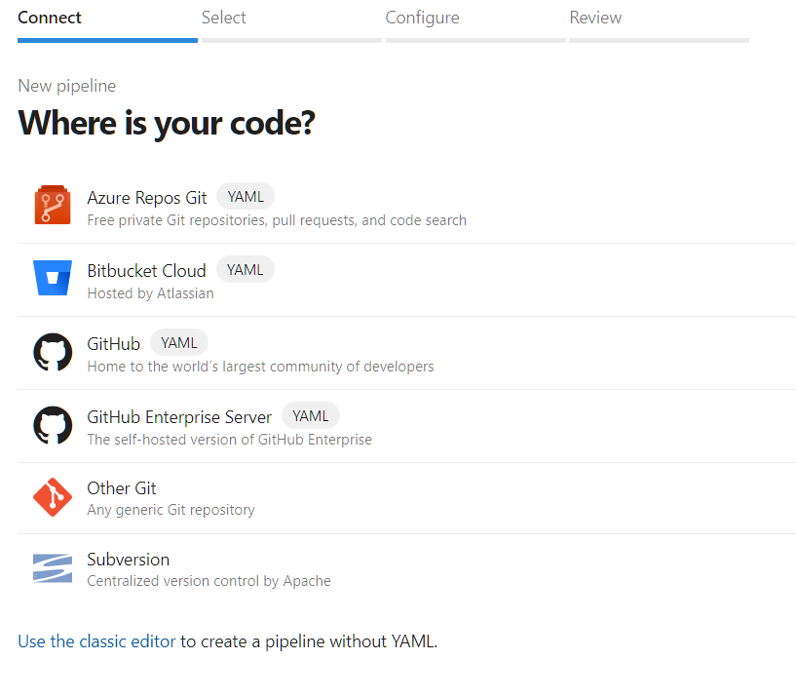
Creating a new pipeline

Slide 13
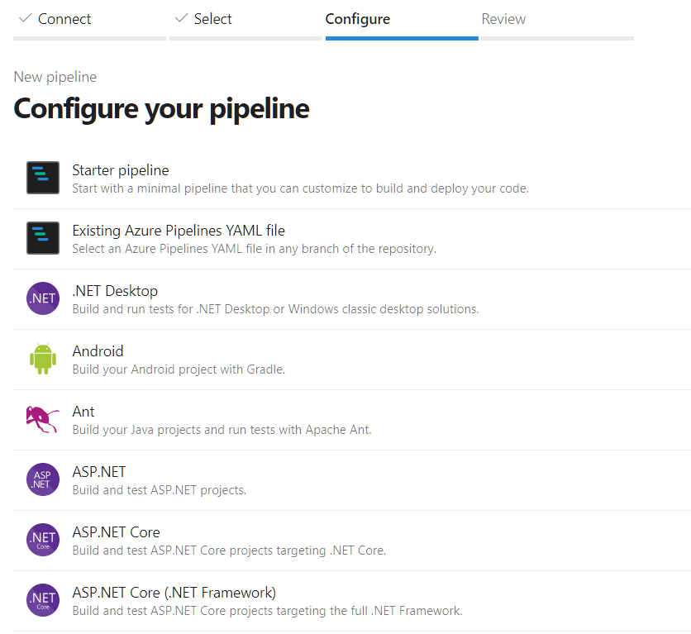

Slide 14
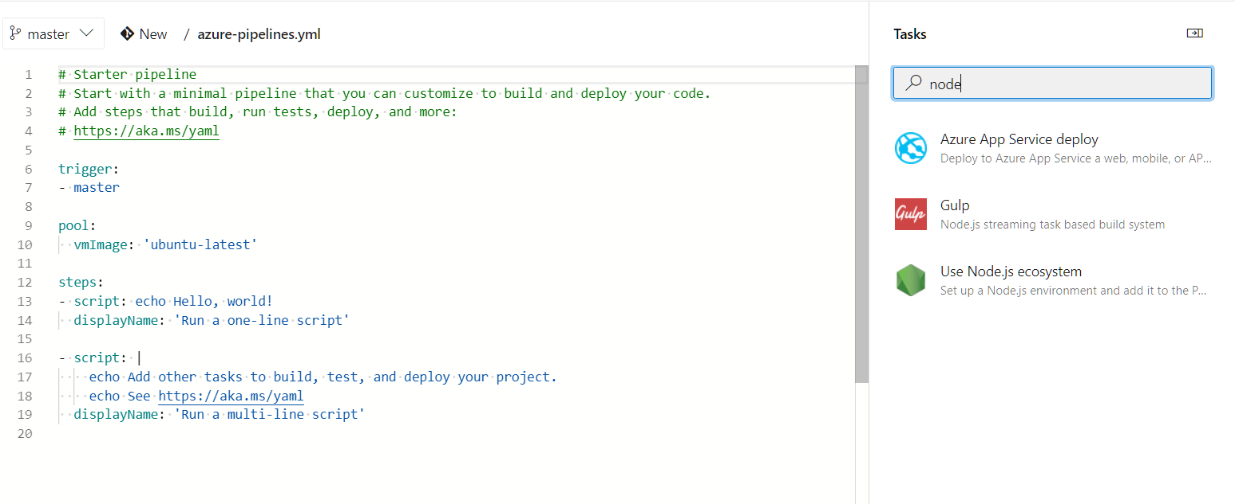

Slide 15
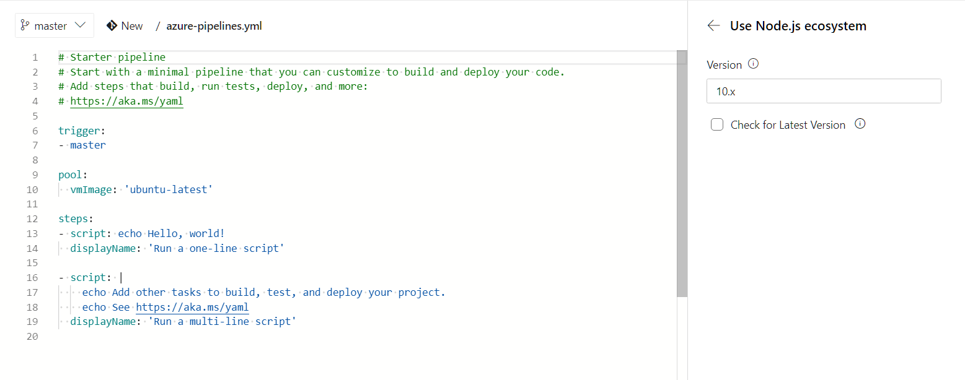

Slide 16
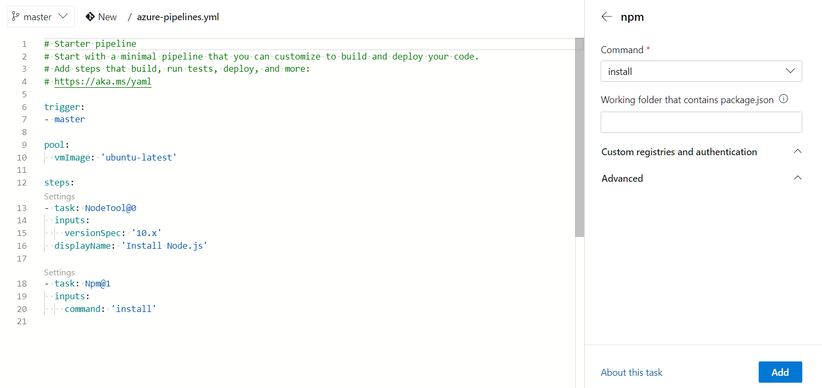
Restoring dependencies

Slide 17
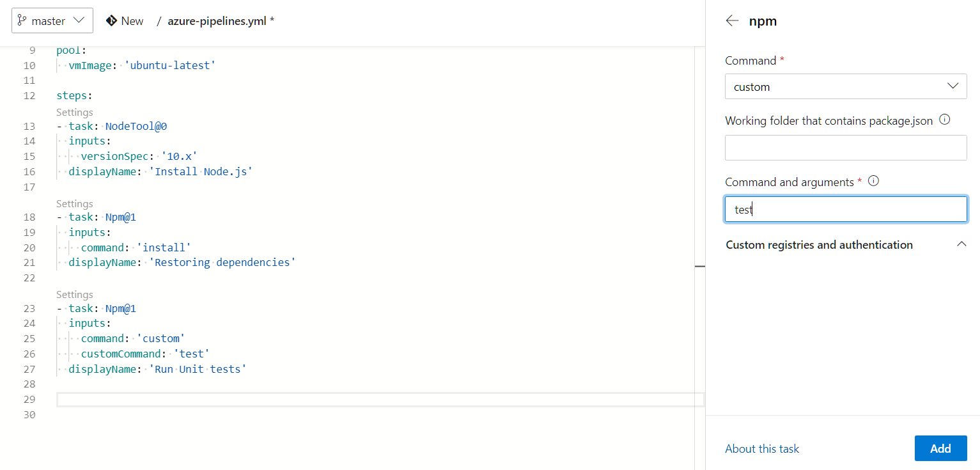
Executing Unit Tests

Slide 18
Configuring Jest
By default SharePoint Framework projects do not include a testing Framework.
We will use Jest as testing framework
npm i jest jest-junit @voitanos/jest-preset-spfx-react16 -D

Slide 19
Writing a unit test
Create a new file src/webparts/webPartName/tests/webPartName.spec.ts and add the tests
Run npm test to execute the unit tests

Slide 20
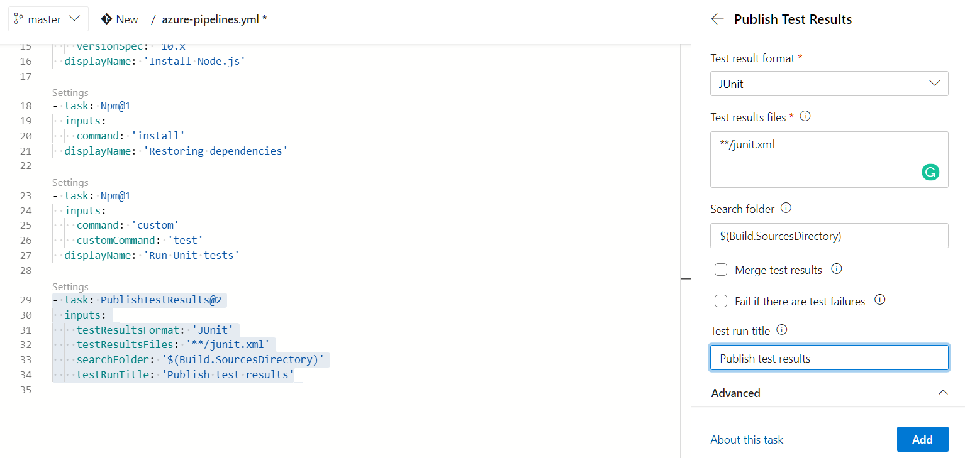
Importing test results

Slide 21
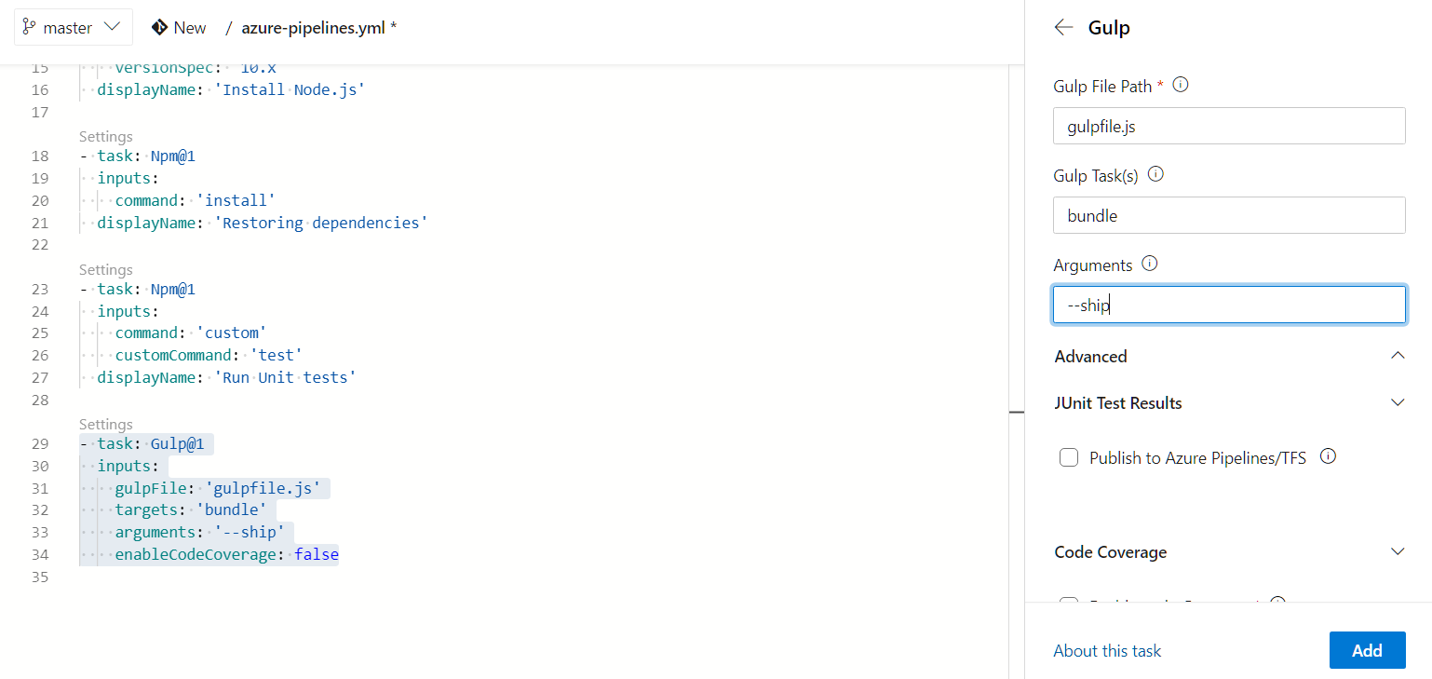
Bundling the solution

Slide 22
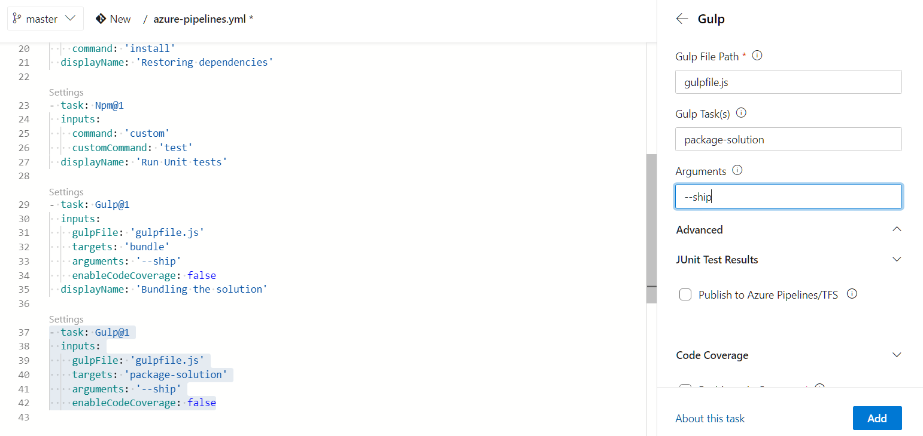
Packaging the solution

Slide 23
Preparing the artifacts
By default, an Azure DevOps build does not retain any files.
To ensure that the required files needed for the release are retained, we need to explicitly indicate which files should be kept.
Add a Copy Files task and set the Contents to **\*.sppkg (the SharePoint Package created with the previous task) and the target folder to $(build.artifactstagingdirectory)/drop.

Slide 24
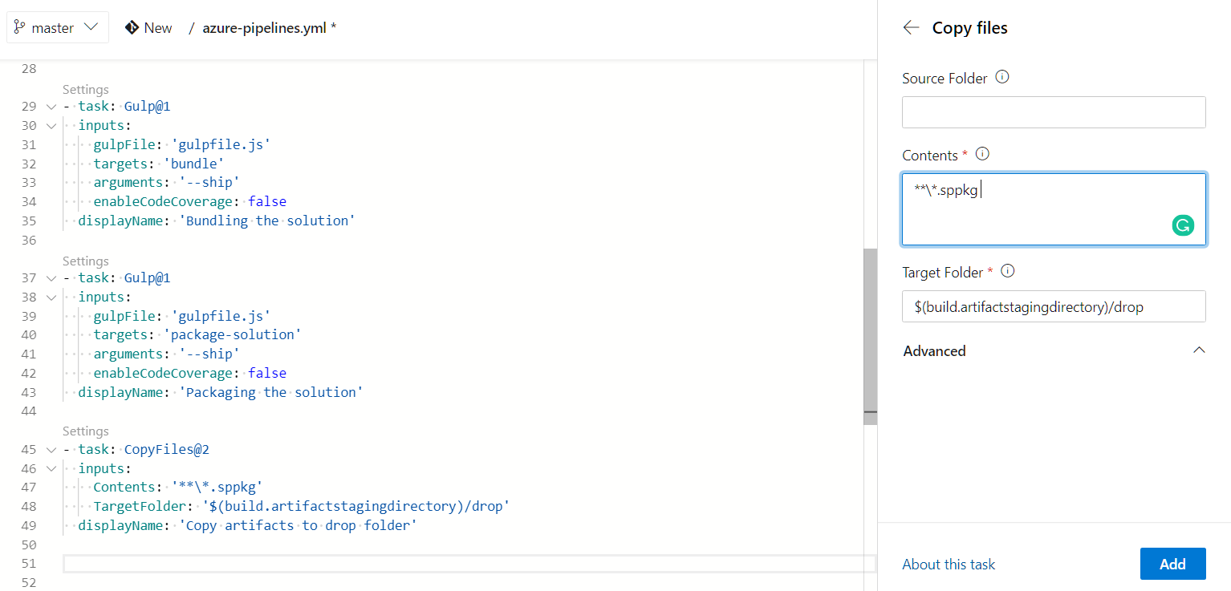

Slide 25
Publishing the artifacts
Now we have collected all the files needed for deployment in a special artifacts folder
We still need to instruct Azure DevOps to keep these files after the execution of the build

Slide 26
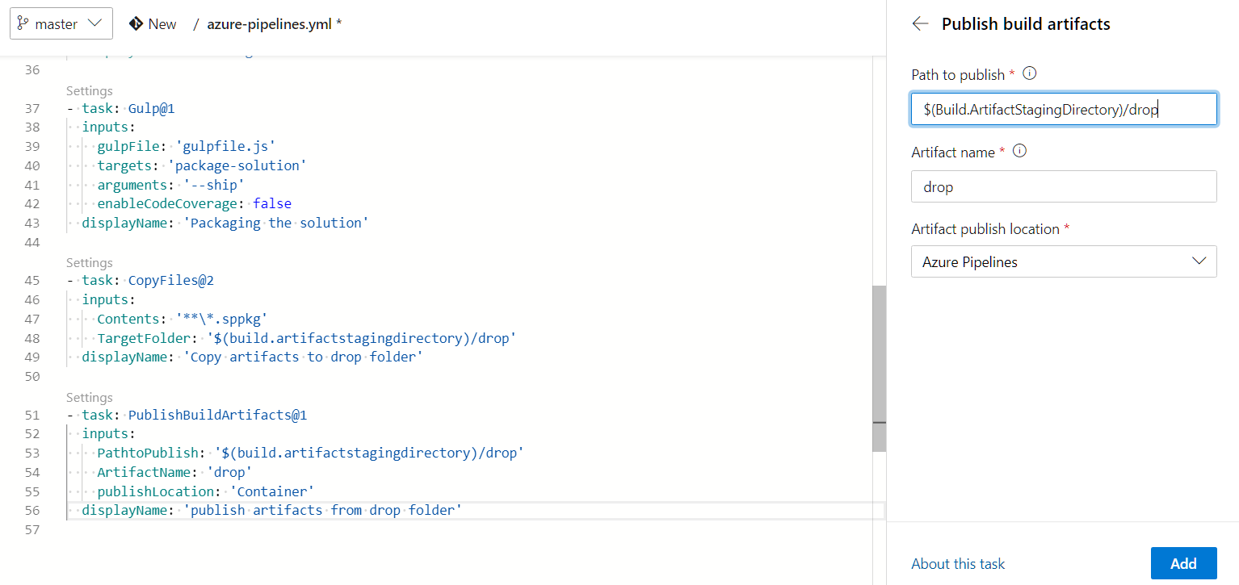

Slide 28
Continuous deployment

Slide 29
Steps
Creating the Release Pipeline
Linking the Build Artifact
Creating the Environment
Installing NodeJS
Installing the Office 365 CLI
Connecting to the App Catalog
Adding the Solution Package to the App Catalog
Deploying the Application
Setting the Variables for the Environment

Slide 30
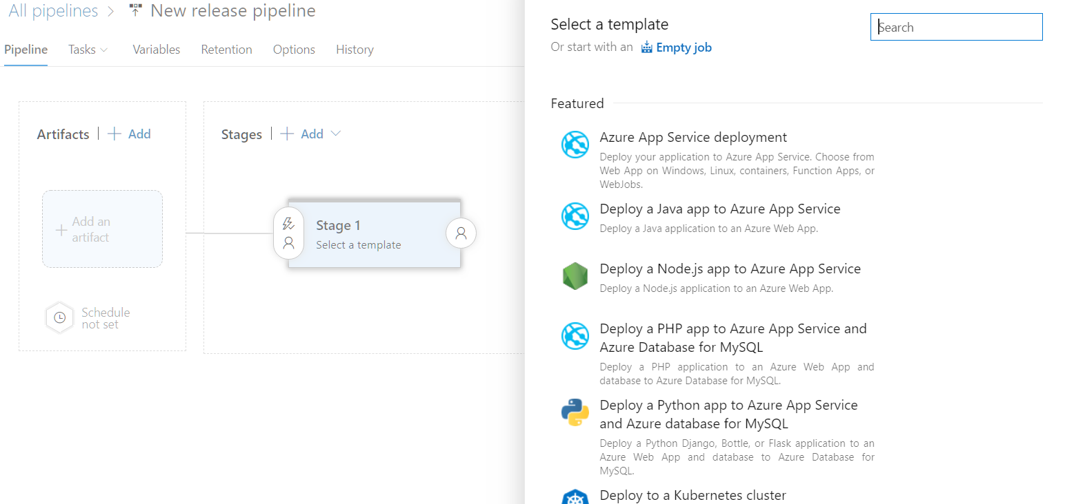
Release pipeline

Slide 31
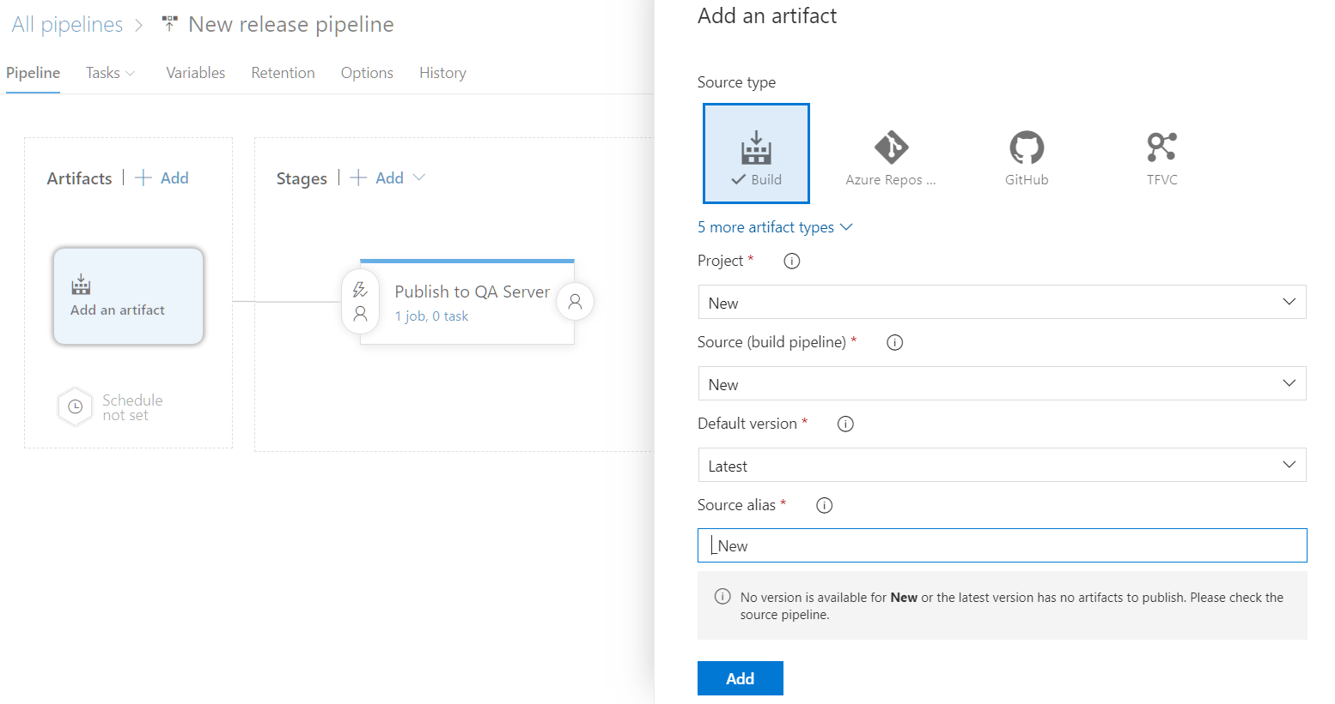
Linking the build artifacts

Slide 32
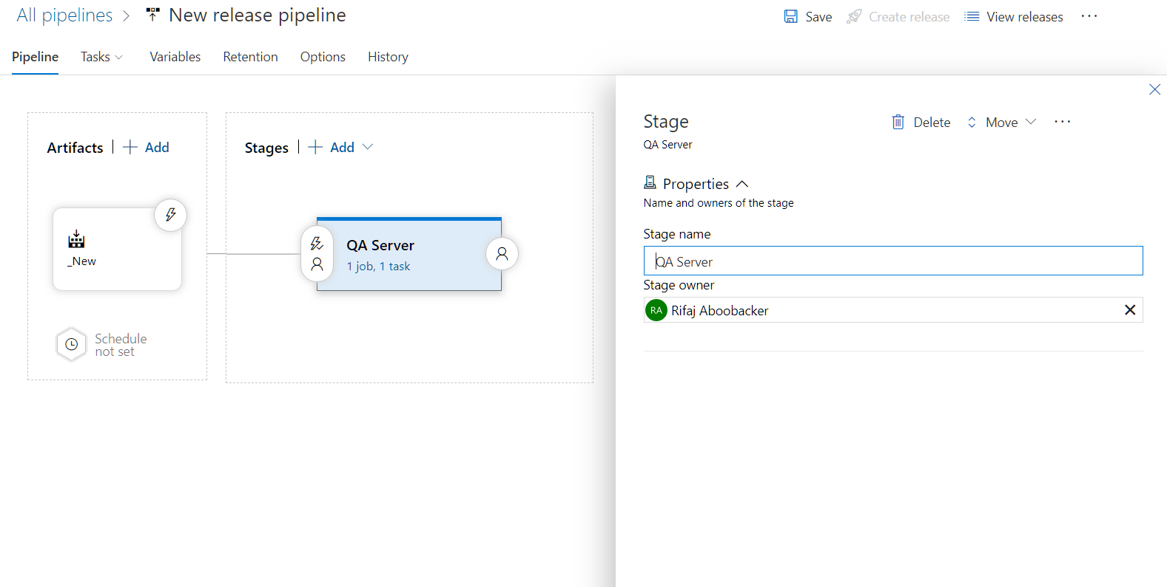
Creating the environment

Slide 33
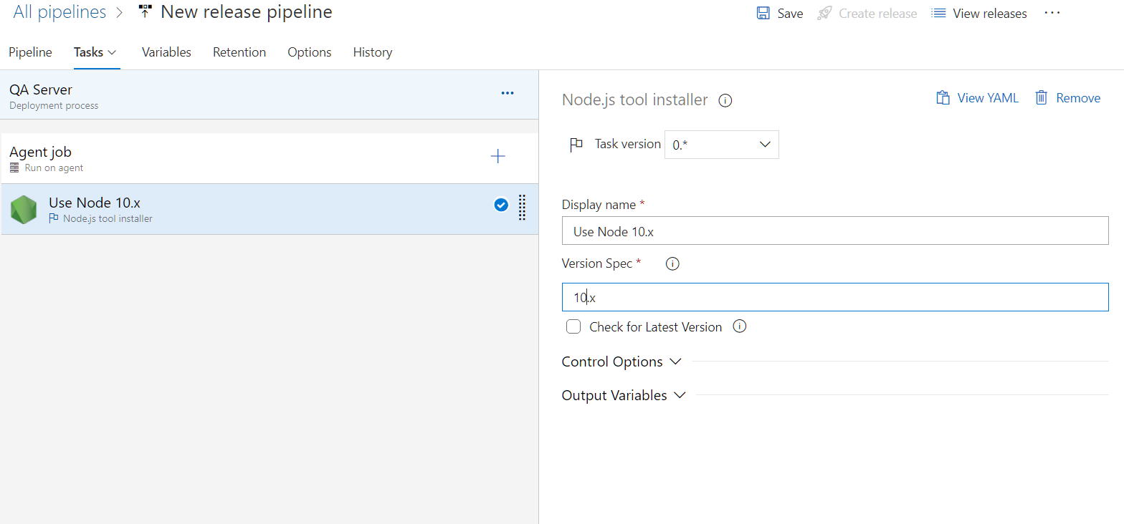
Installing node.js

Slide 34
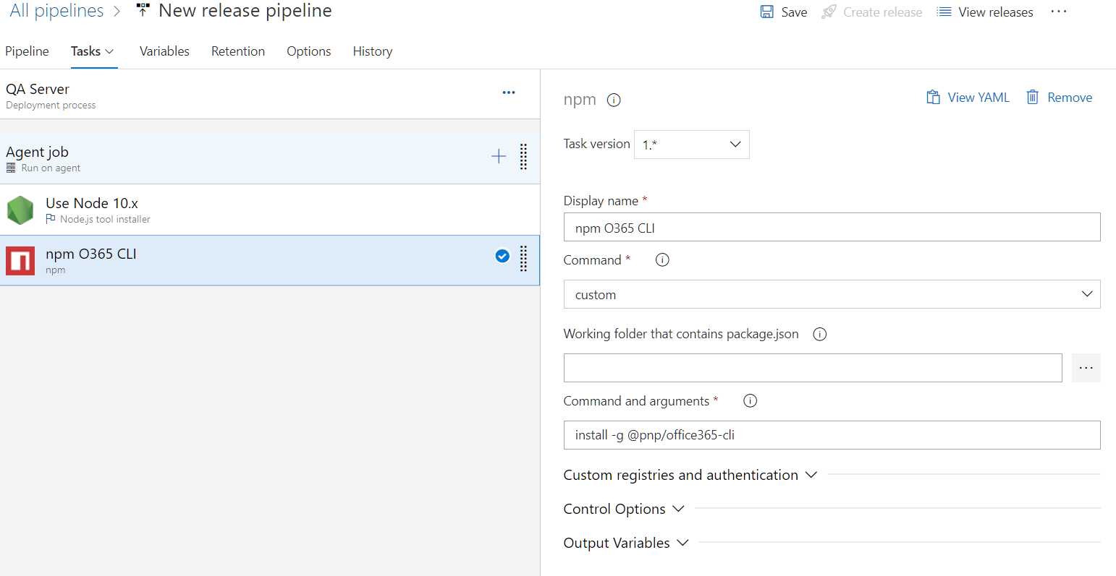
Installing O365 CLI

Slide 35
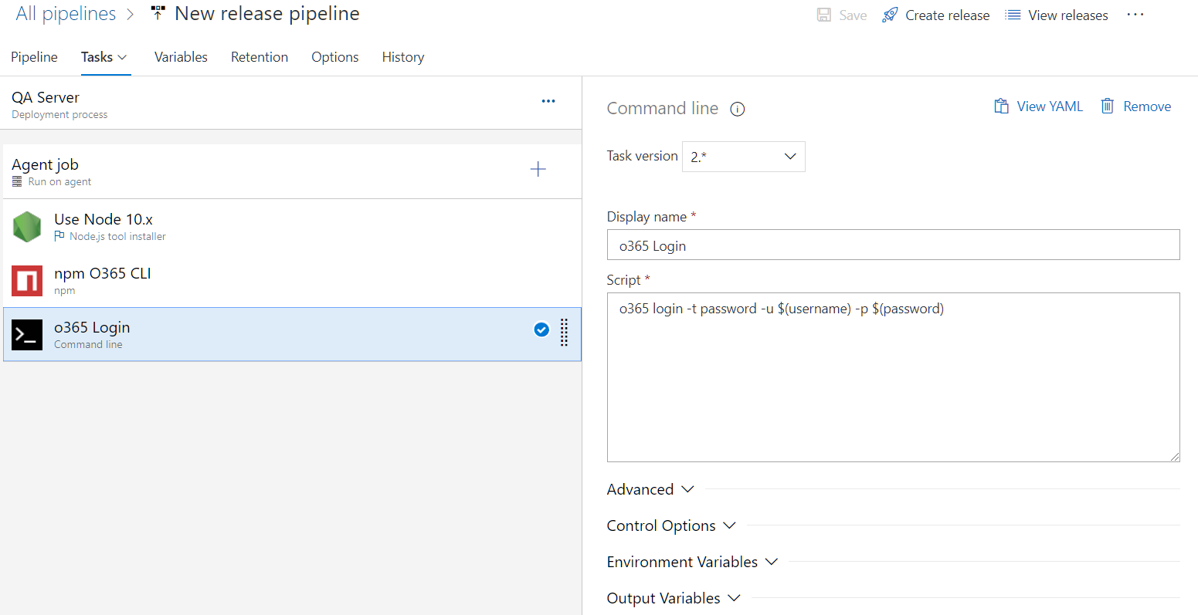
Connect to SPO

Slide 36
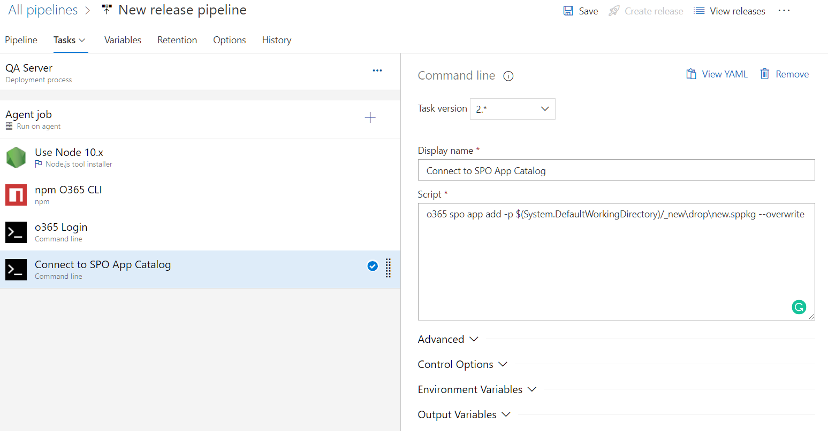
Add package to App Catalog

Slide 37
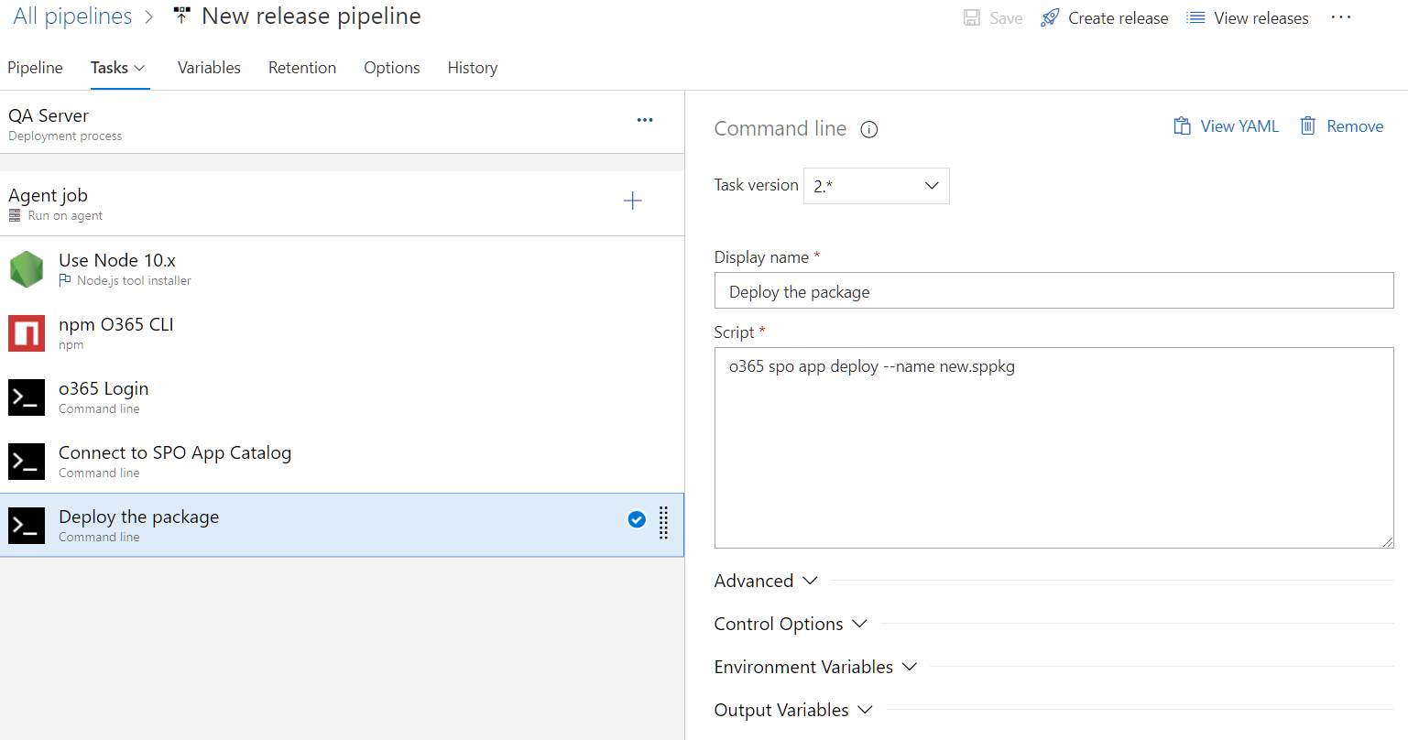
Deploying application

Slide 38
Thank you

